Slide 1
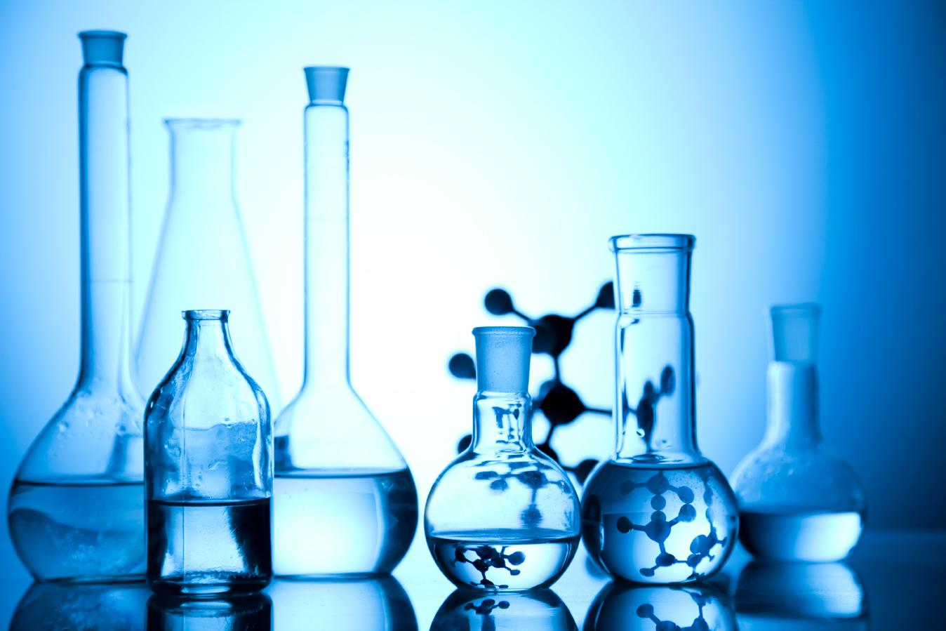

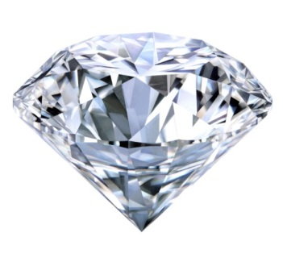
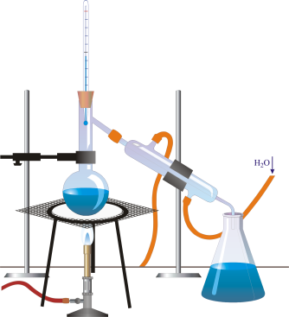
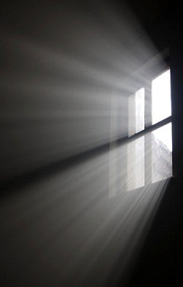
IS MATTER AROUND US PURE

Slide 2

MODULE : 1
Matter and its classification

Slide 3
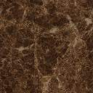
But how do they exist in
nature????
Do they exist as pure
substance?????
IS MATTER AROUND US PURE
In the last chapter we
understood that matter is
divided in to solid, liquid
and gases
Lets understand this
in a chapter called
Or they exist as a
mixture of a substance??

Slide 4
IS
MATTER AROUND US
PURE

Slide 5
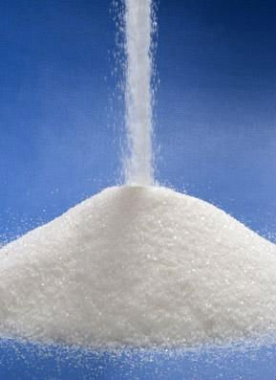
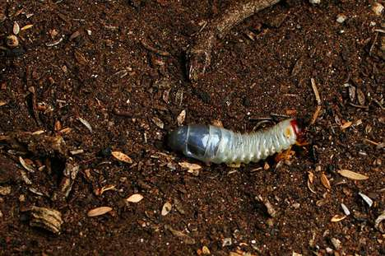
MATTER is made up of tiny particles.
MATTER
Pure
Impure
In this way a substance
consists of a single type of
particle called as
Eg. Sugar, common salt
Eg. Soil, milk
So matter is classified as
Sugar is made up of tiny
particles of Sugar.
Salt is made up of tiny
particles of salt
But there is matter like soil, milk contains many substances .....
As soil contains broken rocks, sand, clay, humus etc..
such matter is
Contains more than one type of substance
Contains only one
type of substance

Slide 6
MATTER
PURE
Pure matter is further
classified as
IMPURE
ELEMENTS
COMPOUNDS

Slide 7

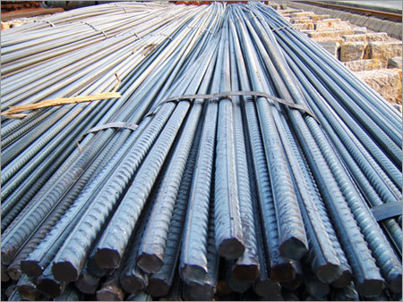
ELEMENTS
ELEMENTS
On hammering iron rods you will get all iron particles. So element is made up of only one kind of substance.
Substance which
cannot be further
divided
Elements are further
classified as
Let us understand elements
in detail
METALS
NON-METALS
METALLOIDS
Atom
An element is a type of matter composed of only one kind of substance where each smallest indivisible part of it has the same properties.

Slide 8
MODULE : 2
Classification of elements . Properties of metals and non metals

Slide 9
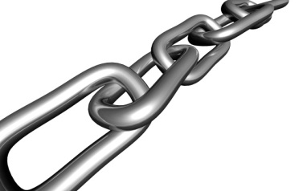
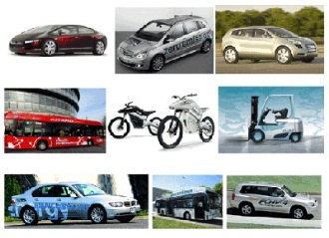
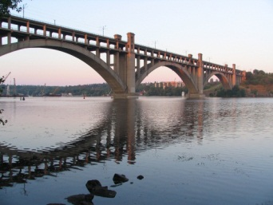
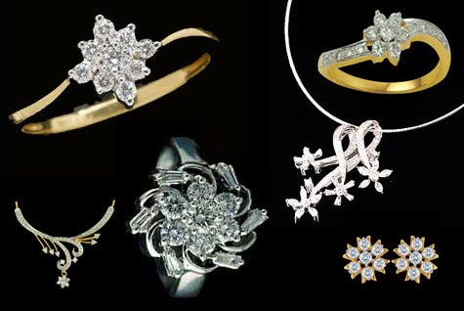
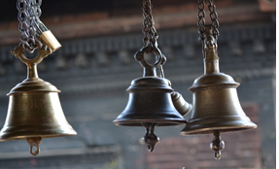
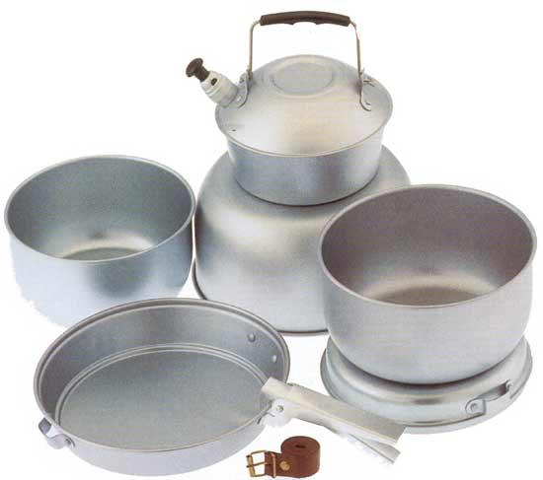
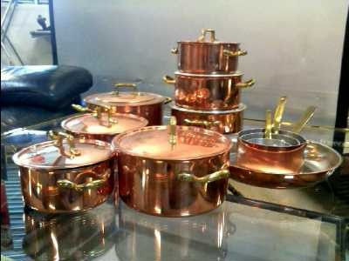
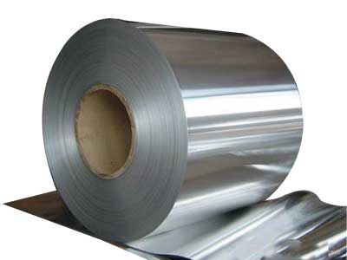
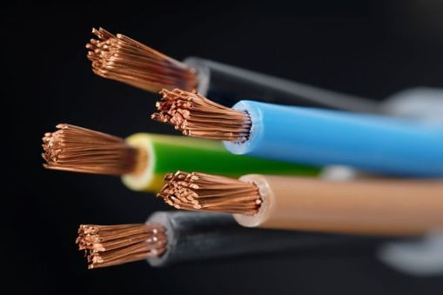
Metals
Lustrous
Sonorous
Ductile
Malleable
Good conductors of heat and electricity.
The cooking utensils and water boilers etc. are usually made of copper and aluminium metals.
Have shining appearance.
Make a ringing sound when we strike them.
They cannot be cut with a knife. Exception sodium and potassium
Can be drawn
(or stretched) in to
thin wires.
Can be beaten into thin sheet with a hammer.
Exception mercury is in liquid state at the room temperature.
Exception sodium and potassium metals have low densities.
Can hold large weight without breaking.
Hard e.g. iron, copper, aluminium
Strong and have high tensile strength
e.g. Iron metal is used in the construction of bridges,
railway lines , vehicles & chains etc.
Generally solids at room temperature
High densities
Allow heat and electricity to pass through them easily.
Silver metal is the best conductor of heat.

Slide 10
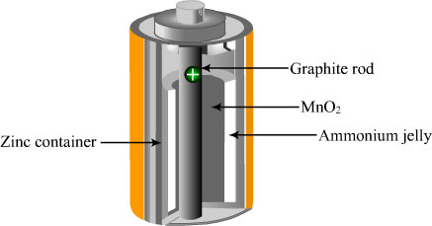
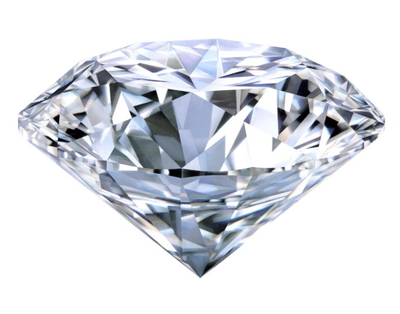
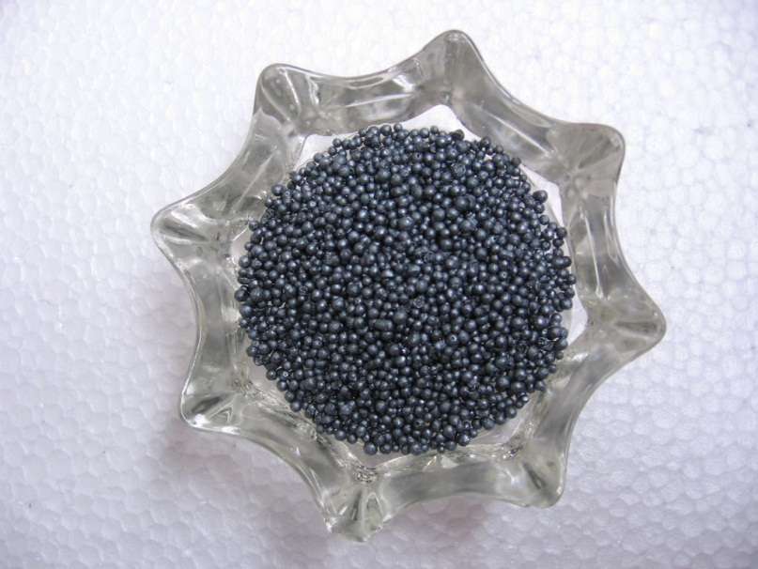
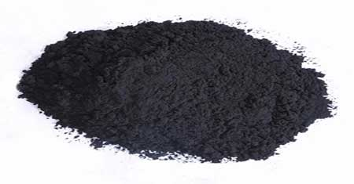
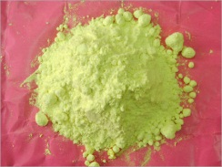
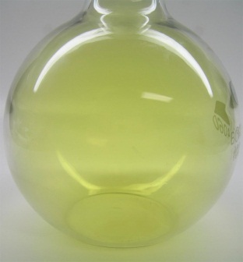
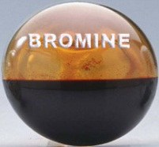
NON METALS
Non lustrous. Exception Iodine has lustre.
Non sonorous
Non ductile
Non malleable
Bad conductors of heat and electricity
Generally soft
Have low tensile strength
Non-metals may be solid, liquid or gases at room temperature
Low melting points and boiling points
Low densities
Exception is diamond, allotropic form of carbon is the hardest natural substance known.
Non-metals cannot hold large weight without breaking.
Bromine is the only non-metal
in liquid state
They are dull in appearance
Non-metals cannot be beaten into thin sheets.
Non-metals cannot be drawn into wire.
They do not make ringing sound when we strike them.
Dry cell
Diamond
Exception graphite form of carbon is a good conductor of electricity.
Exception is graphite which has a high melting point i.e. 3700°C
carbon
Iodine
Sulphur
Chlorine
Bromine

Slide 11
Metals
Non-Metals
Malleable & Ductile
Neither malleable nor ductile.
Non-metals are brittle
Good conductors of
heat and electricity
Bad conductor of
heat and electricity
Lustrous
Non lustrous
Generally solids at room
temperature
May be solid, liquid or gases
at room temperature
High tensile strength
Low tensile strength
Sonorous
Non-Sonorous

Slide 12
MODULE : 3
Metalloids, compounds and their properties

Slide 13
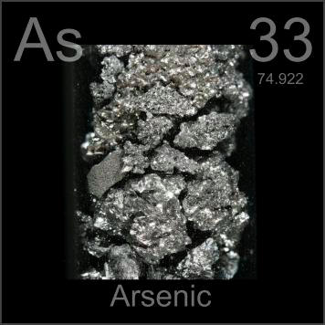
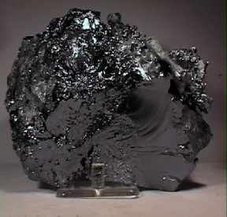
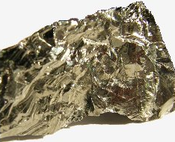
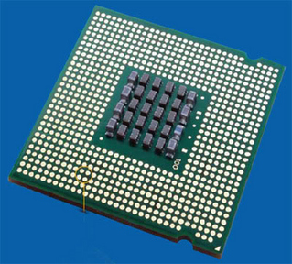
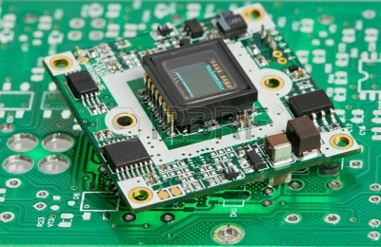
METALLOIDS :-
Metalloids have common characteristics to metals and Non-Metals.
E.gs.-
Arsenic,
Silicon,
Germanium,
Etc………
Arsenic
Silicon
Germanium
Good conductor like metals.
Silicon
Has low melting point like nonmetals.
Used as semiconductors
(for making electronic Chips)

Slide 14
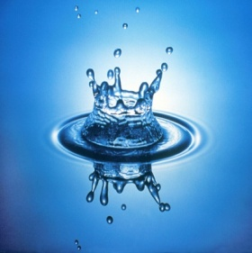
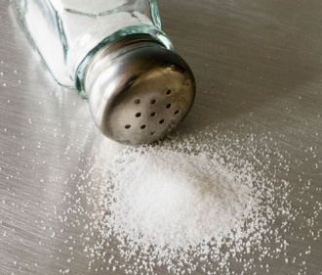
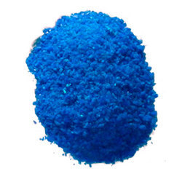
COMPOUNDS
H₂O
NaCl
CuSO₄
Sodium chloride
A compound is the substance made up of two or more types of elements chemically combined in a fixed proportion and it can be further subdivided into simpler substances only by chemical means.
Water
Salt
Copper sulphate
No. of atoms of an element in a compound are always fixed.
Elements of compounds are bonded with imaginary Forces of attraction.
With the help of some chemical reactions

Slide 15
PROPERTIES OF COMPOUNDS
Compound can be further subdivided into simpler substances only by chemical means.
Compound can be represented by using molecular formula. e.g.- H₂O
Compound has totally new properties than the constituents.
e.g. Water (H₂O)
H₂ gas is combustible (Catches fire) and O₂ supports combustion but water extinguishes fire.

Slide 16
MATTER
Impure matter is further
classified as
PURE
IMPURE
ELEMENTS
COMPOUNDS
MIXTURES

Slide 17
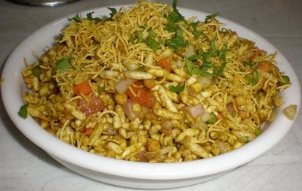
IMPURE MATTER
Is this dish made up of
Same type of substance??????
Which is further divided
As…..
No……..
So this kind of substance is
Known as
How many ingredients do
we have in this??
more than one
Are all ingredients mixed
in fixed proportion ??
All ingredients are mixed
in any proportion
MIXTURE
A mixture is a substance which is obtained by mixing two or more substances in any proportion.

Slide 18
MODULE : 4
Properties and types of mixtures

Slide 19
PROPERTIES OF MIXTURE
The mixture can be further subdivided into simpler substances by simple physical processes like holding a magnet, hand picking etc..
MIXTURES
The constituents of a mixture retain their original properties.
Can we separate this?
Mixtures are further
classified as
Magnet
In a mixture the constituents are not in a fixed proportion.
N
S
HOMOGENOUS
HETEROGENOUS
Sulphur
&
Iron

Slide 20
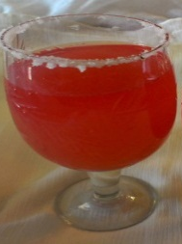
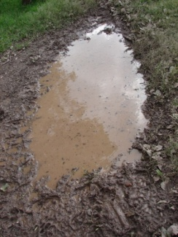
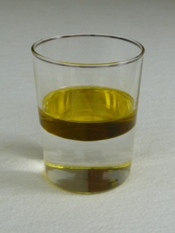
HOMOGENOUS MIXTURE
CLASSIFICATION OF MIXTURES
A homogenous mixture is a mixture in which constituents are uniformly mixed throughout the mixture.
Water +
Sugar +
HOMOGENOUS MIXTURE
HETEROGENOUS MIXTURE
Uniform composition
Not physically distinguishable
Rose syrup
Sherbet
HETEROGENOUS MIXTURE
A heterogeneous mixture is a mixture in which the constituents are not uniformly mixed throughout the mixture.
Non-uniform composition
Physically distinguishable
Muddy water
Water and Oil

Slide 21
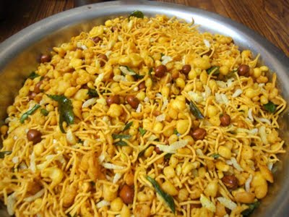
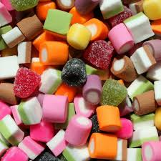
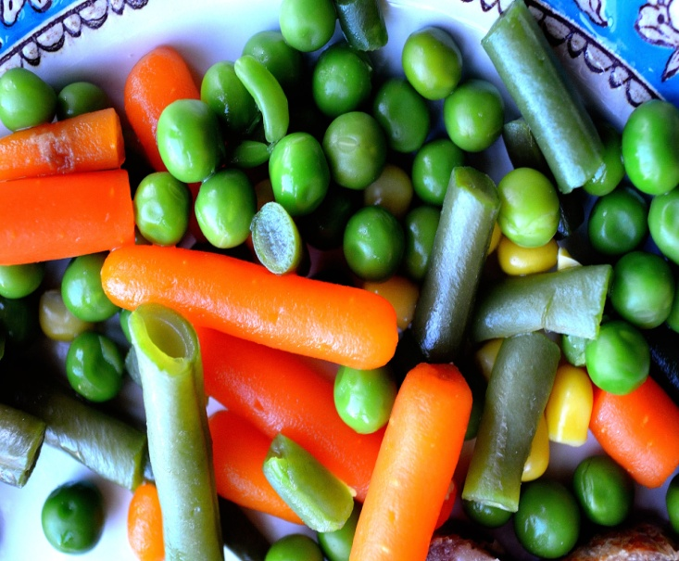
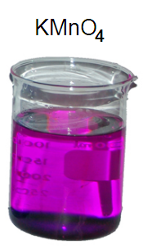
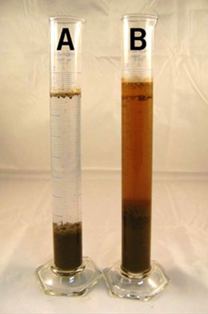
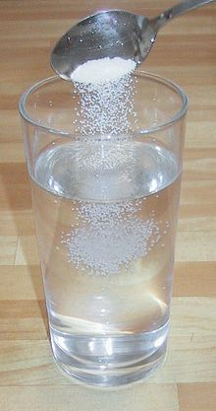
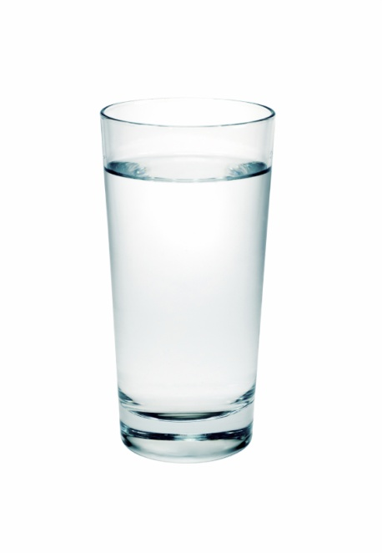
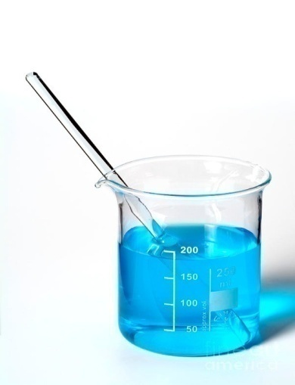
MIXTURE
MIXTURES
HOMOGENOUS
HETEROGENOUS
Heterogeneous mixtures are
further classified as
SOLUTIONS
SUSPENSIONS
COLLOIDS

Slide 22
MODULE : 5
Homogeneous mixture
(solution)

Slide 23
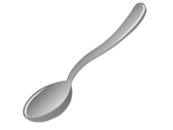
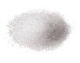
SOLUTION
A solution is a homogenous mixture of two or more substances. Eg.: Alloys, soda water etc.
Salt
The particles spread uniformly
in the solution
Solution
=
Solute
+
Solvent
Substance which dissolves
Substance in which solute dissolves
SMALL QUANTITY
LARGE QUANTITY
Particles in a solution are
Very small in size
Salt Solution

Slide 24
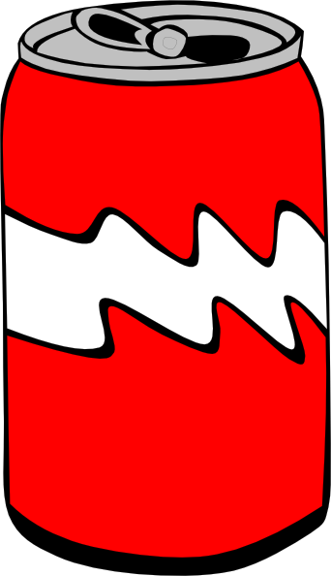
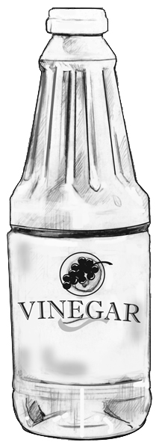
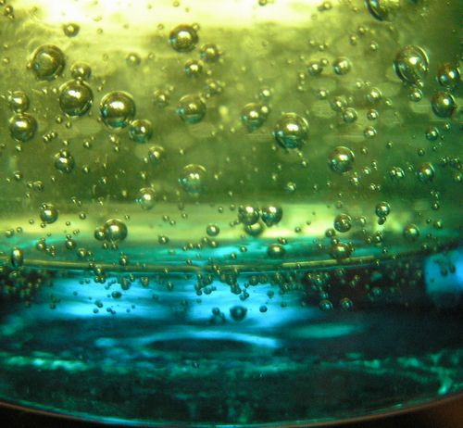
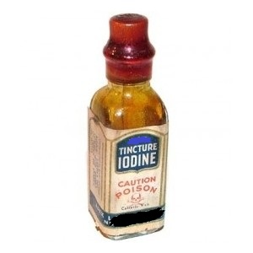






TYPES OF SOLUTION
3) Solution of Liquid in Liquid :
4) Solution of Gas in Liquid :
2) Solution of Solid in Liquid :
5) Solution of Gas in Gas :
1) Solution of Solid in Solid: (Brass)
Gases in any proportion form a homogeneous mixture
Oxygen in water
Alcohol+Water
Carbon dioxide in aerated drink
Vinegar
Salt solution
Salt+Water
Tincture Iodine
Iodine+Alcohol
Acetic acid+Water

Slide 25

PROPERTIES OF SOLUTION
Particle Size : 1nm
Physically undistinguishable, Stable solution
Homogeneous mixture.
Particles are evenly distributed. True solution
Cannot be separated by filtration process
Do not scatter the beam of light, Light path is not visible
NO RESIDUE!!
LIGHT SOURCE
SOLUTION

Slide 26

Concentration of a Solution
Depending upon the amount of solute in solution
Solution
DILUTE
CONCENTRATED
Solution with lesser
amount of solute
Solution with higher
amount of solute

Slide 27
MODULE : 6
Concentration and Numericals

Slide 28

MEASURING CONCENTRATION
MASS BY MASS PERCENTAGE
MASS BY VOLUME PERCENTAGE
Mass of solute x 100
Mass of solution
Mass of solution = mass of solute + mass of solvent
Mass of solute x 100
Volume of solution

Slide 29

Numerical
A solution contains 40g of common salt in 320g of water. Calculate the concentration in terms of mass percentage of solution.
Mass of solute (salt) = 40g
Mass of solvent (water) = 320g
Mass of solution = mass of solute + mass of solvent
= ( 40 + 320 ) g = 360g
Mass percentage of solution =
Mass of solute x 100
Mass of solution
= 40 x 100
360
=
11.1%

Slide 30

Numerical
A solution contains 30g of sugar dissolved in 370g of water. Calculate the concentration of this solution.
Mass of solute (sugar) =30 g
Mass of solvent (water) = 370 g
Mass of solution = mass of solute + mass of solvent
= ( 30 + 370 ) g = 400g
Mass percentage of solution =
Mass of solute x 100
Mass of solution
= 30 x 100
400
7.5 %
=

Slide 31

Numerical
If 110g of sodium chloride is present in 550ml of solution, calculate the concentration of the solution.
Mass of solute (sodium chloride) = 110 g
Volume of solution = 550 mL
Volume percentage of solution =
Mass of solute x 100
Volume of solution
= 110 x 100
550
=
20 %

Slide 32
MODULE : 7
Solubility and factors affecting solubility

Slide 33

DEPENDING UPON THE CONCENTRATION OF SOLUTION
Saturated and Unsaturated solution
A solution in which more quantity of solute can be dissolved without
raising its temperature, is called an unsaturated solution.
SOLUTION
UNSATURATED
SATURATED
Unsaturated solution
Saturated solution
A solution in which no more solute can be dissolved at the temperature,
is called as saturated solution.

Slide 34

SOLUBILITY
Maximum amount of solute which can be dissolved in 100g of a solvent at a specific temperature.

Slide 35



Effect of temperature and pressure on solubility
Solids in liquids
Gases in liquids
Usually decreases on increasing the temperature, Increases on decreasing the temperature
Usually increases on increasing the temperature,
decreases on decreasing the temperature
Remains unaffected by the changes in pressure
Increases on increasing the pressure; and decreases on decreasing
the pressure
Water contains dissolved gases in liquids. when heated the dissolved gases try to escape in the form of tiny bubbles
Aerated drinks contain carbon dioxide gas dissolved in water under pressure. When bottle is opened pressure falls and gas escapes producing a fizz

Slide 36

Effect of heating and cooling on a saturated solution
SATURATED SOLUTION
SATURATED SOLUTION
If a saturated solution at a particular temperature is heated to a higher
temperature, then it becomes unsaturated.
If a saturated solution at a particular temperature is cooled to a lower
temperature, then some of its dissolved solute will separate out in
the form of solid crystal.
Solubility of solid solute
increases on heating and
more of a solute can be dissolved.
HEATING
COOLING
The solubility of solute in the solution
decreases on cooling
The properties is called as precipitation
UNSATURATED SOLUTION
PRECIPITATED

Slide 37
MODULE : 8
Numericals of solubility and suspension

Slide 38
EXAMPLES :
Substance (Solute) | Solubility in water (at 20°C)
Copper Sulphate | 21 g
Potassium Nitrate | 32 g
Potassium Chloride | 34 g
Sodium Chloride | 36 g
Ammonium Chloride | 37 g
Sugar | 204g

Slide 39
A student determined the solubility of 4 substances
KNO₃
NaCl
KCl
NH₄Cl
In water at 5 different temperatures as follows:
Substance | 10°C | 20°C | 40°C | 60°C | 80°C
Potassium Nitrate | 21 g | 32 g | 62 g | 106 g | 167 g
Sodium Chloride | 36 g | 36 g | 36 g | 37 g | 37 g
Potassium Chloride | 35 g | 35 g | 40 g | 46 g | 54 g
Ammonium Chloride | 24 g | 37 g | 41 g | 55 g | 66 g

Slide 40
Q). What mass of KNO₃ would be needed to make a saturated
solution of KNO₃ in 50g of water at 40°C?
Solution :-
The solubility of KNO₃ at 40°C is 62gms this means that 62 gms of KNO₃ is needed to make a saturated solution of KNO₃ in 100 gms of water at 40°C.
to make a saturated solution in 50 gms of water we will require half of 62 gms of KNO₃
which is = 62/2
=31 gms.

Slide 41
SUSPENSIONS
A suspension is a heterogeneous mixture in which the solute particles do not dissolve but remain suspended throughout the bulk of the medium.
These particles are visible
to the naked eye.

Slide 42

PROPERTIES OF SUSPENSION
Particle Size : >100 nm: visible to naked eyes.
Particles remain suspended
Heterogeneous mixture.
Settle down when left undisturbed-unstable
Can be separated by filtration process
Scatter the beam of Light path is visible
LIGHT SOURCE
SUSPENSION

Slide 43
MODULE : 9
Colloid , properties and types

Slide 44



COLLOID
COLLOID
A colloid is a kind of solution in which the size of the solute particles is intermediate between those in true solutions and those in suspension.
DISPERSION MEDIUM
DISPERSED PHASE
Similar to solvent
Similar to solute

Slide 45


PROPERTIES OF COLLOID
Particle Size : 1 nm - 100 nm
Appears homogeneous, but hetrogeneous mixture
Do not settle down when left undisturbed - stable
Cannot be separated by filtration process
Scatter the beam of light, light path is visible “Tyndall Effect”
NO RESIDUE!!
LIGHT SOURCE
INK IN WATER
COLLOID
MILK

Slide 46


Tyndall Effect

Slide 47














TYPES OF COLLOID
TYPE | DISPERSED PHASE | DISPERSED MEDIUM | EXAMPLES
GEL
LIQUID
SOLID
FOG, CLOUDS,MIST
GAS
LIQUID
SHAVING CREAM
EMULSION
LIQUID
GAS
JELLY, CHEESE, BUTTER
LIQUID
LIQUID
FACECREAM, MILK
FOAM
AEROSOL
GAS
FOAM, RUBBER, SPONGE
SOLID
SOLID
SMOKE, EXHAUST
SOL
SOLID
GAS
LIQUID
MILK OF MAGNESIA, MUD
SOLID SOL
SOLID
SOLID
COLOURED GEMSTONE, MILKY GLASS
CLOUD/ MIST/ FOG
COLOURED GEMSTONE
CHEESE
RUBBER
SPONGE
BUTTER
MILK OF MAGNESIA
SHAVING CREAM
JELLY
MUD
FACE CREAM
AUTOMOBILE EXHAUST
MILKY GLASS
SMOKE
MILK

Slide 48
TYPES OF COLLOID
TYPE
DISPERSED PHASE | DISPERSED MEDIUM
EXAMPLES
AEROSOL
LIQUID
GAS
FOG, CLOUDS,MIST
SOLID
GAS
SMOKE, EXHAUST
FOAM
GAS
LIQUID
SHAVING CREAM
GAS
SOLID
FOAM, RUBBER, SPONGE
EMULSION
LIQUID
LIQUID
FACECREAM, MILK
SOL
SOLID
LIQUID
MILK OF MAGNESIA, MUD
GEL
LIQUID
SOLID
JELLY, CHEESE, BUTTER
SOLID SOL
SOLID
SOLID
COLOURED GEMSTONE, MILKY GLASS

Slide 49
To distinguish a colloid from a solution
A solution which scatters a beam of light passing through it renders its
path visible, will be a colloid
The solution which does not scatter a beam of light passing through it
and does not render its path visible, will be a true solution

Slide 50
MODULE : 10
Tyndall effect and distinguish between solution, suspension and colloids

Slide 51


ROBOMATE
Tyndal effect
Because of the small size of particles and their uniform distribution
Beam of light not visible inside a true solution
Beam of light visible inside a colloidal solution
Solution
Colloid
Beam of light

Slide 52
Solution
Suspension
Colloid
Appears to be homogeneous but actually it is heterogeneous
Cannot be separated by filtration
Can be separated by filtration
Cannot be separated by filtration
Homogeneous mixture
Homogeneous mixture
Very stable particles do not separated out on standing
Unstable; particles settle down after sometime
Particle size
≤ 1 nm in diameter
Particle size
≥ 100 nm in diameter
Particle size between 1nm and 100 nm in diameter
Quite stable particles do not separated out on standing
The particles cannot be seen even with a microscope
Scatter a beam of light passing through it
Bigger than those in a true solution but smaller than those in a suspension
The particles cannot be seen even with a microscope
Scatter a beam of light passing through it
Does not scatter light
Can be easily seen

Slide 53
MODULE : 11
Separation of mixture by physical method

Slide 54




Separation of Mixtures
Physical processes used to separate the constituents from a mixture are :-
1) Filtration
2) Sublimation
The various constituents of a mixture have different physical properties such as density, solubility, size of particles, behavior towards magnet, boiling points etc.
3) Centrifugation
On the basis of difference in physical properties of constituents we can separate them from a mixture.
4) Evaporation
5) Crystallisation
6) Chromatography
7) Distillation
8) Fractional distillation
9) Separating funnel
10) Magnet
11) Solvents

Slide 55


i) Using a magnet
Mixture of two solids:
Uses
Two solid substances can be separated by using one of the following method :-
1) To separate a mixture of Iron filings and sulphur powder
i) Using a magnet
The iron filings are attracted
by the magnet.
Iron filings
Iron is attracted by a magnet. This property is used to separate iron from other constituents of mixture.
2) Separation of scrap Iron from other waste materials using electromagnet
ii) Using process of sublimation
-
3) For removal of Iron or steel from a person eye doctors use electromagnets
Sulphur Powder
iii) Using a suitable solvent
Crystallisation
`

Slide 56













SEPARATION OF AMMONIUM CHLORIDE AND COMMON SALT
Uses
Examples of sublimatory substances
Separation by sublimation
Cotton plug
Inverted funnel
Ammonium chloride, Iodine, Camphor, Naphthalene and anthracene can be separated from non-volatile substances like common salt (sodium chloride), sand, iron filings, chalk etc, by the process of sublimation.
The changing of a solid directly into vapours on heating and of vapours into solid on cooling, is known as sublimation
Ammonium Chloride
vapours
Ammonium Chloride collects on the inner sides of the funnel in the form of a sublimate and can be removed.
To prevent the ammonium chloride vapours from escaping into the atmosphere
Common salt remains behind
heating
Mixture of
ammonium chloride
and common salt
The process of sublimation is used to separate sublimatory substance from a mixture.
Solid
Vapour
cooling
China dish
Ammonium chloride
Anthracene
Camphor
Burner
Carbon dioxide
Iodine

Slide 57
MODULE : 12
Separation of mixture by physical method (crystallization)

Slide 58

Separation by a suitable solvent :-
This method is used when there is difference in the solubilities of the constituents for eg. sand and salt can be separated using water as a solvent.
Salt is soluble in water where as sand is insoluble in water. This difference in the solubilities of sand and salt in water is used to separate them.
Salt
Sand
Residue (Sand)
Filtration
Filtrate
(Salt solution)
Salt is soluble in water sand is insoluble
Stir the mixture
Evaporate
Water
Salt

Slide 59
Uses
Separation of carbon and sulphur.
On evaporating the filtrate, Carbon disulphide solvent is evaporated and solid sulphur remains behind.
Both are insoluble in water.
Solvent used is carbon disulphide
Residue (Carbon)
carbon + sulphur mixture in
carbon disulphide
Filtration
Filtrate
(Sulphur solution)
Carbon remains undissolved. The sulphur solution containing carbon is filtered, carbon is obtained as residue and sulphur solution as filtrate
Sulphur is soluble in carbon disulphide where as carbon is insoluble in carbon disulphide
Evaporate
Sulphur

Slide 60









Crystallization
To obtain pure copper sulphate from an impure sample
The process of cooling a hot, concentrated solution of a substance
to obtain crystal is called crystallization
Copper sulphate solution
Filtration
Take about 10 grams of impure copper sulphate and dissolve it in minimum amount of water in a beaker to make
copper sulphate solution.
Obtain saturated solution
Crystal of pure copper sulphate crystal are formed. Impurities remain
behind in the solution
Heat the copper sulphate solution gently to evaporate water and obtain saturated solution
Test for saturated solution???
Cool slowly
Filter the copper sulphate solution to
remove insoluble impurities
Crystal formation
Let us understand this technique with the help of experiment
Separate the copper sulphate crystals from the solution by
the filtration and dry.
Dip a glass rod in hot solution from time to time. When small crystal form on the glass rod, the solution is saturated.
Stop heating

Slide 61






To obtain pure copper sulphate from an impure sample

Slide 62
MODULE : 13
Separation of mixture (Filtration and centrifugation)

Slide 63
Separation of mixture of a solid and liquid
All the mixtures containing a solid and a liquid are separated by one of the following processes
Filtration
Filtration is used for separation of a heterogeneous mixture of a solid and liquid using a filter paper .
Filtration
Centrifugation
Evaporation
Crystallization
Chromatography
Distillation
Lets separate mud water mixture

Slide 64
Separation of a mixture by filtration
ROBOMATE
Mud+water
Filter paper cone
stand
Insoluble solid obtained on filter paper is called Residue
Funnel
Residue
Clear solution is called filtrate
Beaker
Filtrate

Slide 65



Uses
Different filters used in every day life are wire-mesh, piece of cotton, muslin cloth
The used tea leaves are separated from prepared tea
Home filters

Slide 66


Centrifugation
Centrifugation is a method for separating the suspended particles of a substance from a liquid in which the mixture is rotated
(using centrifugal force) at a high speed in a centrifuge.
Denser particles are forced to the bottom and the lighter particles stay at the top when spun rapidly.
What is centrifugal force?
A revolving object exerts a force away from the centre of rotation called centrifugal force.

Slide 67







Uses
WASHING MACHINE
SEPARATION OF CREAM FROM MILK
BLOOD CENTRIFUGING
To dry cloths in washing machines by squeezing out water from wet cloths

Slide 68
MODULE : 14
Evaporation and distillation

Slide 69


Evaporation
A solid non-volatile component of the mixture is separated from its liquid component by allowing the Liquid component [Solvent] to vaporize completely
Take Sodium chloride in a spatula and dissolve it in beaker with water
Residual
sodium chloride
Take a beaker filled with water in it
Evaporating dish
Sand bath

Slide 70


Crystallization is a better technique than evaporation to dryness
Some solids (like sugar) decompose or get charred
on heating to dryness during evaporation.
The soluble impurities do not get removed in the process
of evaporation. But such impurities get removed in crystallization.

Slide 71

ROBOMATE
Distillation
Distillation
70
Thermometer
60
Condenser is a wide glass tube where outer tube is provided with an inlet and outlet for cold water circulation
The condensed pure water is collected in the receiver flask
The water evaporates and water vapour condenses in the condenser
Solid impurities in water remains in the distillation flask
Add impure water to the
distillation flask
The flask is carefully heated
40
Water condenser
Soluble solid constituent of a mixture is separated from its liquid constituent by evaporation of liquid component and followed by condensation of the vapours obtained
10
0
Water in
Receiver flask

Slide 72
MODULE : 15
Separating funnel and magnetic separation

Slide 73

Separation of mixture of a liquid and liquid
Immiscible liquids
Liquids which do not mix with each other
Using separating funnel
E.g.
Oil and water
Chloroform and water
kerosene and water
Miscible liquids
Liquids which mix with each other
Distillation
Fractional distillation
E.g.
E.g.
Acetone and water
Separation of liquefied air
Alcohol and water
Separation of petroleum products
Distillation is used for the separation of miscible liquids that boil without decomposition and have sufficient difference in their boiling points.
Fractional distillation is used for the separation of miscible liquids for which the difference in their boiling points is less than 25K.

Slide 74
SEPARATING TWO IMMISCIBLE LIQUIDS
Mixture of OIL & WATER
Immiscible liquids separate out in layers depending on their densities using separating funnel
Allow it to stand for sometime so that separate layers of oil and water is formed
Separating funnel
Close the stopcock of the separating funnel as the oil reaches the stop-cock
On opening the stopcock, pour out the lower layer of water
Low density liquid (oil)
forms upper layer
Oil
High density liquid (water) forms lower layer
Mixture of
OIL & WATER
Water
OIL
Stopcock
WATER

Slide 75

Application
Industrial separation of iron ore from gangue
The pulverized mixture [ore] added through hood onto the conveyor belt
Magnetic Separation
The solid-solid components pass over the magnetic wheel
The magnetic particles are attracted to the magnetic wheel and fall separately apart from the non-magnetic particles
Electro magnetic wheel
Non-magnetic particles
Magnetic particles

Slide 76
MODULE : 16
Chromatography

Slide 77




CHROMATOGRAPHY
This technique was first used for separation of colours.
Kroma in greek means colour,
so this name was given
Draw a line on it with a pencil, approximately 3cm above the lower edge
Take a thin strip of filter paper
Put a small drop of water soluble ink from a sketch pen at the centre of the line
Lower the filter paper into a jar containing water so that the drop of ink on the paper is just above the water level and leave it undisturbed
Separated
Components
The solvent (water) flows over the spot and carries the components of ink to distances along the paper based on their solubilities
The separation of components of ink is observed by coloured spots
WATER

Slide 78



CHROMATOGRAPHY
Applications
1. To separate colours in a dye
Is the dye in black ink a single colour?
2. To separate pigments from natural colours
What is the reason for the rise of the coloured spot on the filter paper ?
3. To separate drugs from blood
A dye is a mixture of two or more colours.
The coloured component that is more soluble in water, rises faster.

Slide 79
MODULE : 17
Fractional distillation

Slide 80
ROBOMATE
Fractional Distillation
Thermometer
Water out
Fractionating column is fitted in between the distillation flask and the condenser
Higher boiling component is vapourised and condensed and collected as second fraction
It is packed with glass beads to increase the surface area for the vapours to cool and condense repeatedly
Water condenser
Low boiling component is vaporized first and condensed and collected as first fraction
Temperature gradient is formed in fractionating column
Higher boiling component is vapourised and condensed and collected as second fraction
Two miscible liquids having close boiling points can be separating using fraction distillation
Water in
Beaker
First fraction
(more volatile)
Second fraction
(less volatile)
Miscible liquids
xxxxxxxxxxxxxxxx
Wire gauze

Slide 81
Separation of gases of the air
Air is a homogeneous mixture
COMPONENTS OF AIR
OTHERS
0.05%
NITROGEN
78.03%
OXYGEN
20.99%
ARGON
0.93%

Slide 82
SEPARATION OF COMPONENTS OF AIR
COMPRESS
& COOL
WARMED SLOWLY
LIQUID AIR
OTHERS
AIR
COMPONENTS OF AIR
CARBON DIOXIDE
-57 C
NITROGEN
-196⁰C
OXYGEN
-183 C
ARGON
-186 C

Slide 83
MODULE : 18
Fractional distillation of Air

Slide 84




Hot air
Water out
Separate air
Air Under Pressure
Fractional Distillation column
Liquid air
Nitrogen out
Argon out
Liquid
Oxygen
Carbon dioxide out as a dry ice
Air in
Expansion jet
Liquid nitrogen (present in liquid air ) has the lowest boiling point of , -196⁰ C. So, on warming, liquid nitrogen gas is collected from the top part of the fractional distillation column.
Liquid oxygen (present in liquid air) has a still higher boiling point of -183⁰ C. So, liquid oxygen boils off last and collected as oxygen gas from the bottom of the fractional distillation column.
Freezing cold water in
Liquid argon (present in liquid air) has a slightly higher boiling point of -186⁰C .So, liquid argon boils off next and collected as argon gas in the middle part of the fractional distillation column.
Filter
Air is filtered to remove dust, then water vapour and carbon dioxide are removed.
Because they solidify and choke the filtration pipes
The liquid air is fed into a tall fractional distillation column from near its bottom and warmed up slowly.
This cooled air is allowed to expand quickly into a chamber through a jet . This expansion cools the air even move.
By applying high pressure and then cooled.
1.Air is filtered
2.Air is Compressed
SEPARATION OF COMPONENTS OF AIR

Slide 85
Thank You

